Slide 1










AI MEMORY
RECONSTRUCTION
Semantic RetriVal + AI-Based Memory Reconstruction
AI
DIGITAL ACTIVITY
MEMORY
AI
RECONSTRUCTED MEMORY
B.Tech CSE Major Project
Team Members
Sameer Singh Modanwal
Mansi
Anshika
Mukul Sharma

Slide 2
























WHY
01
AI MEMORY
DIGITAL ACTIVITIES
02
RECONSTRUCTION?
SCATTERED INFORMATION
03
Every day, we create a flood of digital traces
Important moments get buried and hard to recall
Information lives in scattered silos
Keyword search relies on exact words
We need understanding, not just matching
AI helps rebuild meaningful memories
DIFFICULT TO SEARCH
04
RELEVANT MEMORY RETRIEVAL
05
AI MEMORY RECONSTRUCTION
LEARNING
COLLEGE
PROJECTS
YOUTUBE
NOTES
DEVELOPMENT

Slide 3


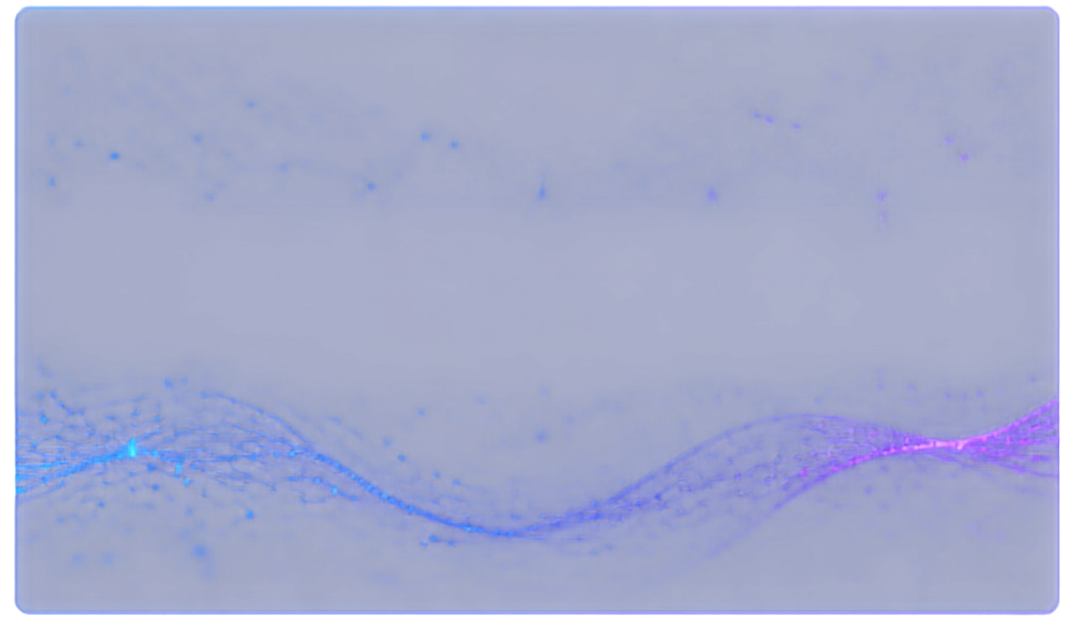











OBJECTIVE & PROPOSED SOLUTION
OBJECTIVES
SOLUTION
01
Store activities as structured memories.
02
Search memories with natural-language questions.
User Activity
Structured Memory
Semantic Retieval
Relevant Memories
AI Reconstruction
Natural-Language Answer
03
Retrieve relevant memories using semantic similarity.
04
Reconstruct useful answers using an LLM.
05
Provide the system via an API.
From scattered activity to
meaningful memory.

Slide 4




















SYSTEM
USER QUESTION
ARCHITECTURE
FASTAPI
FastAPI
API layer
SEMANTIC SEARCH
Semantic Search
Meaning-based retrieval
SQLite Database
SQLITE DATABASE
Structured memory storage
Cosine Similarity
Similarity measurement
TOP-K RELEVANT MEMORIES
TOP-K = 3
Top-K = 3
Relevant memory selection
AI
GROQ LLM
Groq LLM
AI response generation
RECONSTRUCTED ANSWER

Slide 5
























IMPLEMENTATION &
MEMORY RETRIVAL
TECHNOLOGIES USED
MEMORY SCHEMA (YOURMEMORY)
SEMANTIC RETRIVAL FLOW
Python
SQLite
FastAPI
Sentence Transformers
Cosine Similiarity
Groq
date
time
source
activity
category
content
tags
01
02
03
04
05
06
USER
QUERY
QUERY
EMBEDDING
COMPARE
WITH MEMORY
EMBEDDINGS
COSINE
SIMILARITY
RANK
MEMORIES
TOP-K = 3
Semantic search retrievals conceptually relevant memories instead of relying only on exact keywords.

Slide 6















HOW MEMORY
RECONSTRUCTION WORKS
EXAMPLE
1
USER QUESTION
Natural-language question about past activity.
Question:
“What did I learn about searching algorithms?”
2
Find memories related to meaning.
Retrieved Memories:
SEMANTIC RETRIEVAL
Binary search tutorial
Binary search practice
Binary search interview questions
3
Select highest similarity results.
TOP RELEVANT MEMORIES
4
CONTEXT CREATION
Combine retrieved records into useful context.
Reconstructed Answer:
“You learned about binary search through tutorials, practiced multiple problems, and explored interview questions.”
5
Generate natural-language response using context.
GROQ LLM
Return concise answer based only on available memories.
6
RECONSTRUCTED MEMORY
Only retrieved memory is used for reconstruction.

Slide 7
















RESULTS &
FUTURE SCOPE
EVALUATION
CURRENT LIMITATIONS
FUTURE WORK
Keyword RetrievAl Baseline — 20 Test Queries
Semantic retrieval can miss explicit temporal constraints.
Hybrid semantic + temporal + metadata retrieval
Precision
87.75%
Free LLM APIs have usage limits.
Authorized real-world data ingestion
Recall
100.00%
Current prototype uses a structured sample dataset.
92.02%
Larger evaluation dataset
F1 Score
Real-world data requires authorized data imports.
Improved memory organization
Do NOT present as semantic search results.
More robust retrieval evaluation
01
02
03
04
05
CURRENT SYSTEM
HYBRID RETRIEVAL
BETTER DATA INGESTION
LARGER EVALUATION
ADVANCED MEMORY SYSTEM

Slide 8










THANK YOU
QUESTIONS & DISCUSSION
AI MEMORY RECONSTRUCTION
Sameer Singh Modanwal
Mansi
Anshika
Mukul Sharma
DIGITAL ACTIVITY
STRUCTURED MEMORY
AI
MEANINGFUL MEMORY

